Slide 1
操作系统习题课
作业四&作业七

Slide 2
作业4.1
1、Why is multi-threading needed and what are its benefits?
解： Why is multi-threading needed
Multi-threading design allows an application to do parallel tasks simultaneously.
Benefits of Multi-thread
Responsiveness and multi-tasking Ease in data sharing Economy Scalability

Slide 3
作业4.2
2、Which of the following components of program state are shared across threads in a multithreaded process?
a. Register values
b. Heap memory
c. Global variables
d. Stack memory
解：bc
The threads of a multithreaded process share heap memory and global variables.
Each thread has its separate set of register values and a separate stack.

Slide 4
作业4.3
3、What are the two models of interprocess communication? What are the strengths and weaknesses of the two approaches?
解：Shared memory Establish a shared memory region, read/write to shared region Accesses are treated as routine memory accesses Faster Message passing Exchange message Require kernel intervention Easier to implement in distributed system

Slide 5
作业4.4
4、Consider the following code segment:
pid t pid;
pid = fork();
if (pid == 0) { /* child process */
fork();
thread create( . . .);
}
fork();
解：a. How many unique processes are created?
6.
b. How many unique threads are created? 2.

Slide 6
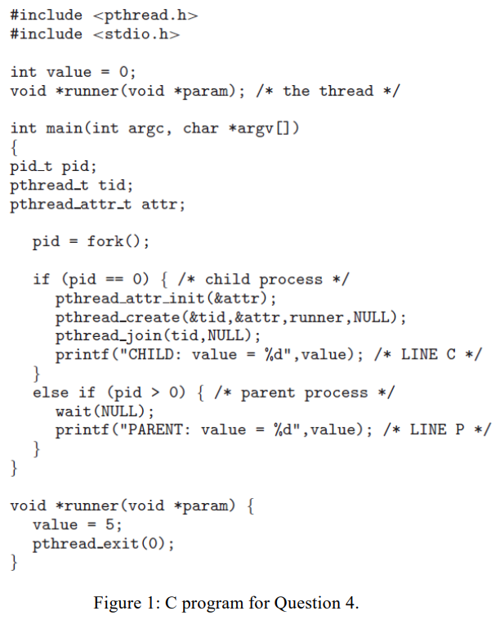
作业4.5
5、The program shown in Figure 1 uses the Pthreads API. What would be the output from the program at LINE C and LINE P?
解： LINE C
CHILD: value = 5
LINE P PARENT: value = 0

Slide 7
作业4.6
6、What are the differences between ordinary pipe and named pipe?
解： Ordinary pipe
Ordinary pipes are used only for related processes (parent-child relationship) Ordinary pipes are unidirectional (one-way communication) Ceases to exist after communication has finished
Named pipe
No parent-child relationship is necessary
Several processes can use the named pipe for communication (may have several writers) Continue to exist until it is explicitly deleted Communication is bidirectional (still half-duplex)

Slide 8
作业7.1
1、What is the difference between data segment and BSS?
解：Data segment
Containing initialized global and static variables.
Allocate the required space during compile time, and preserve them in the program file.
BSS
Containing uninitialized global and static variables.
Only preserve a bunch of symbols in the program file and Allocate the required space to the process once it starts executing.

Slide 9
作业7.2
2、Explain the following terms:
解：a. Segmentation fault
When you are accessing a piece of memory that is not allowed to be accessed, then the OS returns you an error called segmentation fault. b. TLB
Translation lookaside buffer, a memory cache that stores recent translations of virtual memory to physical addresses for faster retrieval.
c. Page fault
When a program attempts to access an invalid virtual page, then the CPU generates an interrupt called page fault.

Slide 10
作业7.2
2、Explain the following terms:
解：d. Demand paging
Demand paging is a type of swapping in which pages of data are not copied from disk to memory until they are needed.
e. Thrashing
Frequent page fault because replace a page that will be needed again right away, which is called thrashing. It causes more time spending on paging than executing

Slide 11
作业7.3
3、Explain what Belady’s anomaly is, and when it will happen?
解： Belady’s anomaly
Belady’s anomaly is the phenomenon in which increasing the number of page frames results in an increase in the number of page faults for certain memory access patterns.
This phenomenon is commonly experienced when using the FIFO page replacement algorithm.

Slide 12
作业7.4
4、Assuming a 1-KB page size, what are the page numbers and offsets for the following address references (provided as decimal numbers):
解：a. 3085 page = 3; offset = 13 b. 42095 page = 41; offset = 111 c. 215201 page = 210; offset = 161 d. 650000 page = 634; offset = 784 e. 2000001 page = 1953; offset = 129

Slide 13
作业7.5
5、Consider a logical address space of 256 pages with a 4-KB page size, mapped onto a physical memory of 64 frames.
解：a. How many bits are required in the logical address?
12 + 8 = 20 bits.
b. How many bits are required in the physical address? 12 + 6 = 18 bits.

Slide 14
作业7.6
6、Consider a paging system with the page table stored in memory.
解：a. If a memory reference takes 50 nanoseconds, how long does a paged memory reference take?
100 ns : 50 ns to access the page table and 50 ns to access the word in memory.
b. If we add TLBs, and 75 percent of all page-table references are found in the TLBs, what is the effective memory reference time? (Assume that finding a page-table entry in the TLBs takes 2 nanoseconds, if the entry is present.). Effective access time = 0.75 × (2 + 50) + 0.25 × (2 + 50 + 50) = 64.5 ns.

Slide 15
作业7.7
7、Assume a program has just referenced an address in virtual memory. Describe a scenario how each of the following can occur: (If a scenario cannot occur, explain why.).
解：• TLB miss with no page fault
Page has been brought into memory, but has been removed from the TLB. • TLB miss and page fault
Page fault has occurred.

Slide 16
作业7.7
7、Assume a program has just referenced an address in virtual memory. Describe a scenario how each of the following can occur: (If a scenario cannot occur, explain why.).
解：• TLB hit and no page fault
Page is in memory and in the TLB. Most likely a recent reference. • TLB hit and page fault
Cannot occur. The TLB is a cache of the page table. If an entry is not in the page table, it will not be in the TLB.

Slide 17
作业7.8
8、What is the copy-on-write feature, and under what circumstances is it beneficial?
解：Copy-on-write
Copy-on-write technique allows the parent and the child processes to share pages after the fork() system call is invoked. A new, separated page will be copied and modified only when one of the processes wants to write on a shared page. When two processes are accessing the same set of program values (for instance, the code segment of the source binary), then it is useful to map the corresponding pages into the virtual address spaces of the two programs in a write-protected manner. When a write does indeed take place, then a copy must be made to allow the two programs to individually access the different copies without interfering with each other.

Slide 18
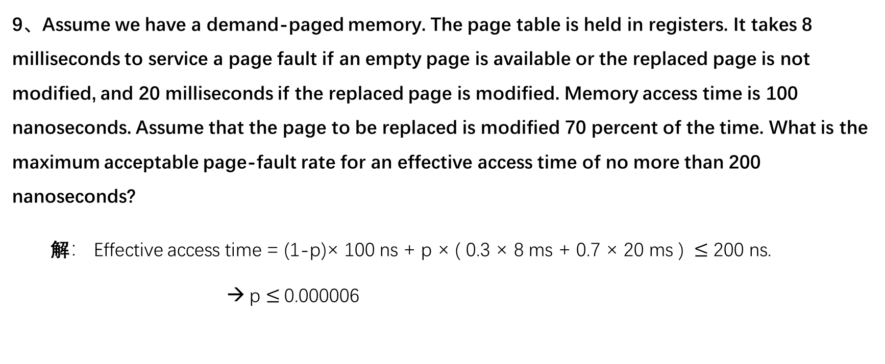
作业7.9
9、Assume we have a demand-paged memory. The page table is held in registers. It takes 8 milliseconds to service a page fault if an empty page is available or the replaced page is not modified, and 20 milliseconds if the replaced page is modified. Memory access time is 100 nanoseconds. Assume that the page to be replaced is modified 70 percent of the time. What is the maximum acceptable page-fault rate for an effective access time of no more than 200 nanoseconds?
解： Effective access time = (1-p)× 100 ns + p × ( 0.3 × 8 ms + 0.7 × 20 ms ) $≤$ 200 ns. → p $≤$0.000006

Slide 19
作业7.10
10、Consider the following page reference string: 7, 2, 3, 1, 2, 5, 3, 4, 6, 7, 7, 1, 0, 5, 4, 6, 2, 3, 0, 1. Assuming demand paging with three frames, how many page faults would occur for the following replacement algorithms?
解：• LRU replacement
18. • FIFO replacement
17. • Optimal replacement
13.

Slide 20
作业7.11
11、Suppose that a disk drive has 5,000 cylinders, numbered 0 to 4999. The drive is currently serving a request at cylinder 2150, and the previous request was at cylinder 1805. The queue of pending requests, in FIFO order, is: 2069, 1212, 2296, 2800, 544, 1618, 356, 1523, 4965, 3681 Starting from the current head position, what is the total distance (in cylinders) that the disk armmoves to satisfy all the pending requests for each of the following disk-scheduling algorithms?
解：a. FCFS
The FCFS schedule is 2150, 2069, 1212, 2296, 2800, 544, 1618, 356, 1523, 4965, 3681. The total seek distance is 13,011.
b. SSTF
The SSTF schedule is 2150, 2069, 2296, 2800, 3681, 4965, 1618, 1523, 1212, 544, 356. The total seek distance is 7586.

Slide 21
作业7.11
11、Suppose that a disk drive has 5,000 cylinders, numbered 0 to 4999. The drive is currently serving a request at cylinder 2150, and the previous request was at cylinder 1805. The queue of pending requests, in FIFO order, is: 2069, 1212, 2296, 2800, 544, 1618, 356, 1523, 4965, 3681 Starting from the current head position, what is the total distance (in cylinders) that the disk armmoves to satisfy all the pending requests for each of the following disk-scheduling algorithms?
解：c. SCAN
The SCAN schedule is 2150, 2296, 2800, 3681, 4965, 2069, 1618, 1523, 1212, 544, 356. The total seek distance is 7492.
d. LOOK
The LOOK schedule is 2150, 2296, 2800, 3681, 4965, 2069, 1618, 1523, 1212, 544, 356. The total seek distance is 7424.

Slide 22
作业7.11
11、Suppose that a disk drive has 5,000 cylinders, numbered 0 to 4999. The drive is currently serving a request at cylinder 2150, and the previous request was at cylinder 1805. The queue of pending requests, in FIFO order, is: 2069, 1212, 2296, 2800, 544, 1618, 356, 1523, 4965, 3681 Starting from the current head position, what is the total distance (in cylinders) that the disk armmoves to satisfy all the pending requests for each of the following disk-scheduling algorithms?
解：e. C-SCAN
The C-SCAN schedule is 2150, 2296, 2800, 3681, 4965, 356, 544, 1212, 1523, 1618, 2069. The total seek distance is 9917. f. C-LOOK
The C-LOOK schedule is 2150, 2296, 2800, 3681, 4965, 356, 544, 1212, 1523, 1618, 2069. The total seek distance is 9137.

Slide 23
作业7.12
12、. Requests are not usually uniformly distributed. For example, we can expect a cylinder containing the file-system metadata to be accessed more frequently than a cylinder containing only files. Suppose you know that 50 percent of the requests are for a small, fixed number of cylinders.
解：a. Would any of the scheduling algorithms discussed in our course be particularly good for this case? Explain your answer.
SSTF would take greatest advantage of the situation. FCFS could cause unnecessary head movement if references to the “high-demand” cylinders were interspersed with references to cylinders far away.

Slide 24
作业7.12
12、. Requests are not usually uniformly distributed. For example, we can expect a cylinder containing the file-system metadata to be accessed more frequently than a cylinder containing only files. Suppose you know that 50 percent of the requests are for a small, fixed number of cylinders.
解：b. Propose a disk-scheduling algorithm that gives even better performance by taking advantage of this “hot spot” on the disk. We can design a modified SSTF as : First detect the “hot spot” area, then add the policy that if the disk becomes idle for more than, say, 50 ms, the operating system generates an anticipatory seek to the hot region, since the next request is more likely to be there.

